Slide 1
ISBN -13: 978-1540827685
Genre: Historical Fiction

Slide 2
Vocabulary, Grammar and punctuation exercises images

Slide 3
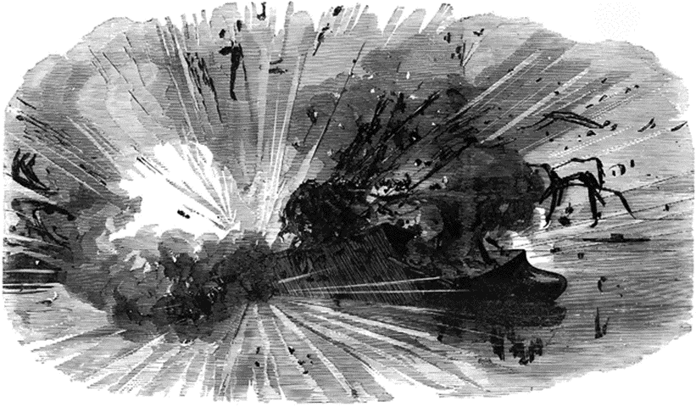
B)
Write three adjectives to describe the picture below:
Page 3

Slide 4
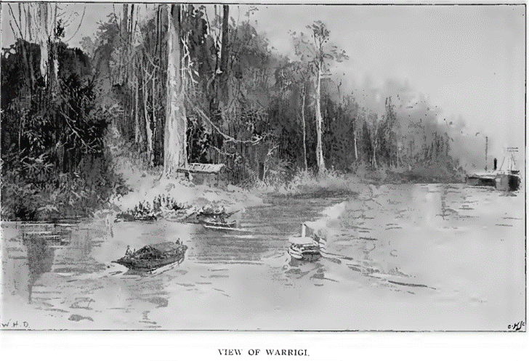
Page 4
C) Quick composition

Slide 5
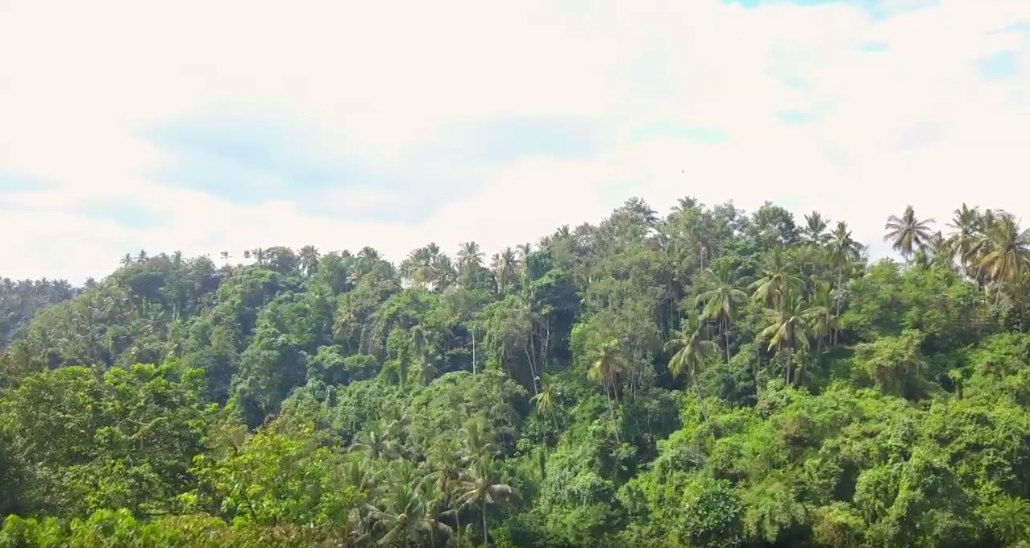
Page 4

Slide 6
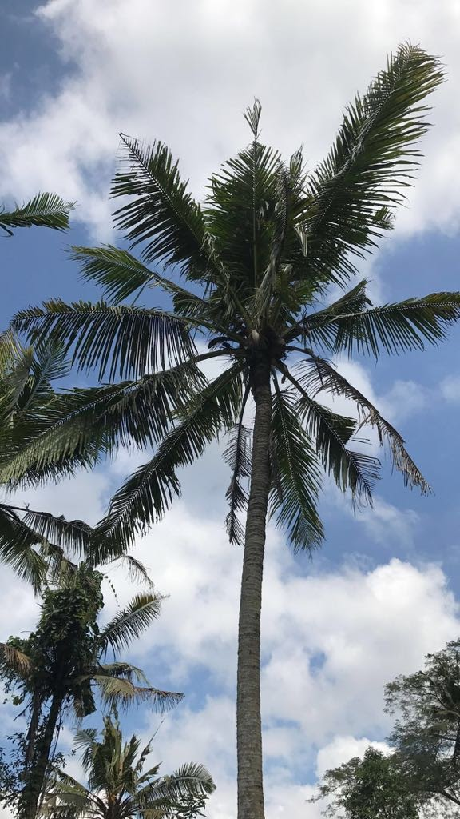
Page 139
The coconut Tree
Write a short information text
on the Coconut tree.
Use:
Heading
Subheading
Uses as raw material & food
Table on nutrition facts
Drawing or photograph
http://www.sciencekids.co.nz/sciencefacts/food/coconuts.html

Slide 7
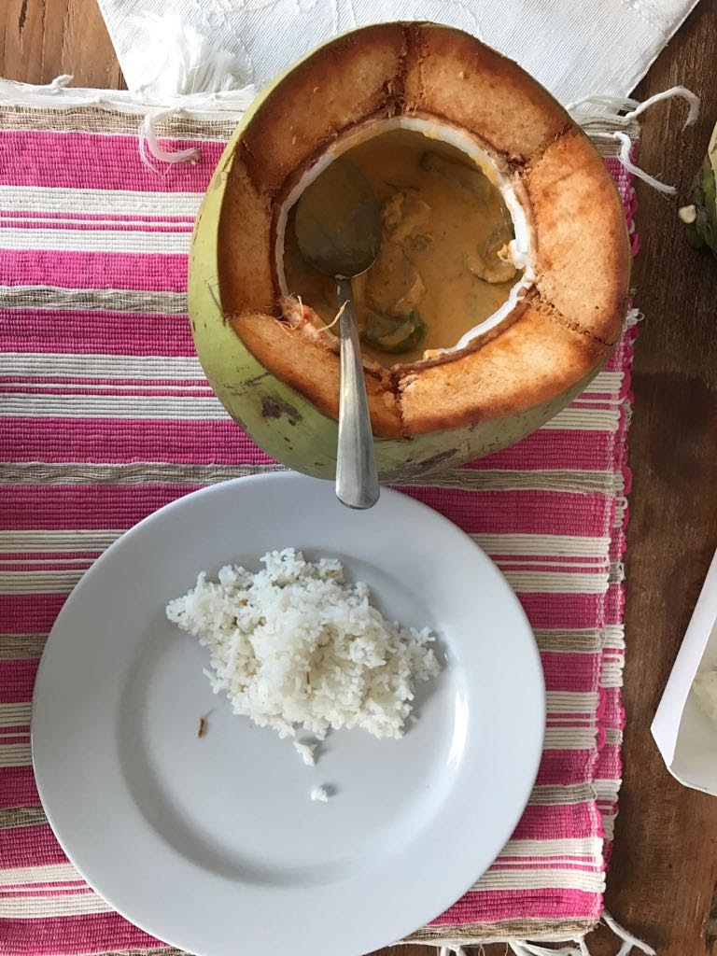
The coconut used as a stew bowl
Write a sentence about this photograph:
A simple sentence
A compound sentence
Write a complex sentence about the meal
Which includes parenthesis
Extension: use dialogue
https://www.theschoolrun.com/what-are-simple-compound-and-complex-sentences-0

Slide 8
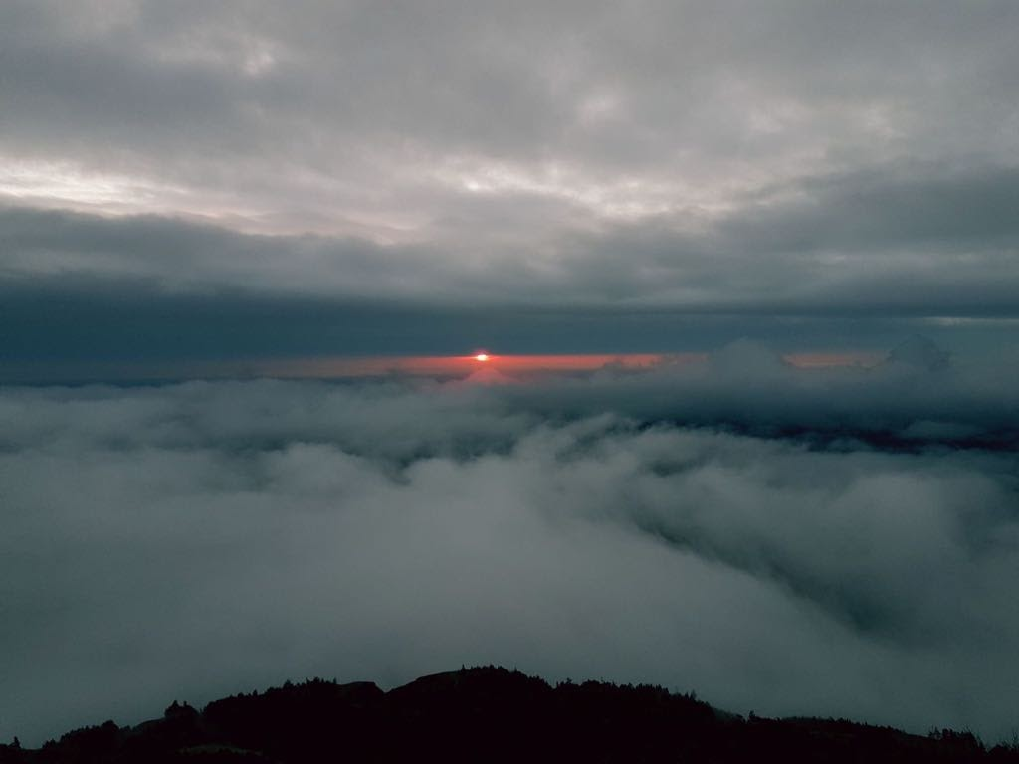
Page 132
Look at this
Photograph.
Write a
sentence
with a comma
and a dash.

