Slide 1
Picture Talks

Slide 2
Discussing the photographs
What is happening in this photograph?
Who are these people?
Why are they in the photo?
Which character stands out for you and why?
What happened 5 minutes before this photograph was taken?
What happened five minutes after this photo was taken?
What is happening right now in the photograph? Look closely at each person.
Combine the above sequence into a narrative story.
Dramatize and video record your narrative story.
In groups form tableau for each part above and present to rest of the class.
Take photos of your framed tableau. Display with the original photo.

Slide 3
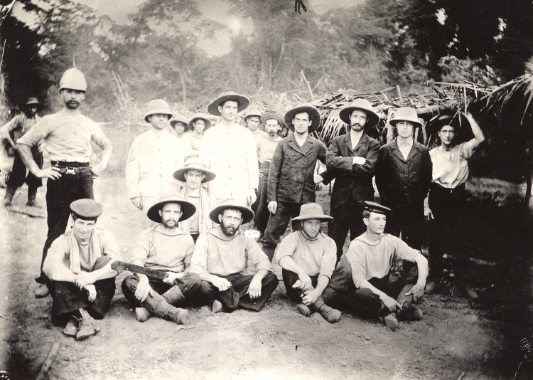

Slide 4
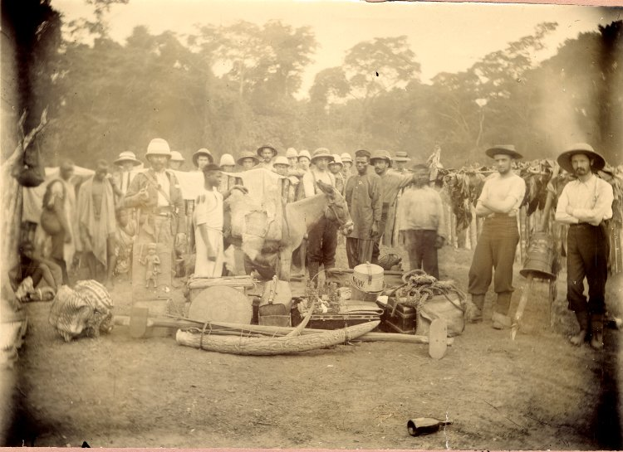

Slide 5
Photos from British Museum online collection
Page 3 →
Page 4 →

